Slide 1
Data Mining With Weka
Hands-on Tutorial on the open-source
java-based Data Mining Toolbox Weka
Alban@ihr.mrc.ac.uk

Slide 2
This Tutorial:
Practical experience with Weka
Download software
Load datasets
Run algorithms
Understand underlying models
Explanation of basic principles of Machine Learning
Supervised/unsupervised learning
A bit of theory
Evaluation metrics
Interfacing Matlab with Weka
Use Java objects and methods from Matlab

Slide 3
NO MATHS TODAY
Notes:
The good thing is

Slide 4
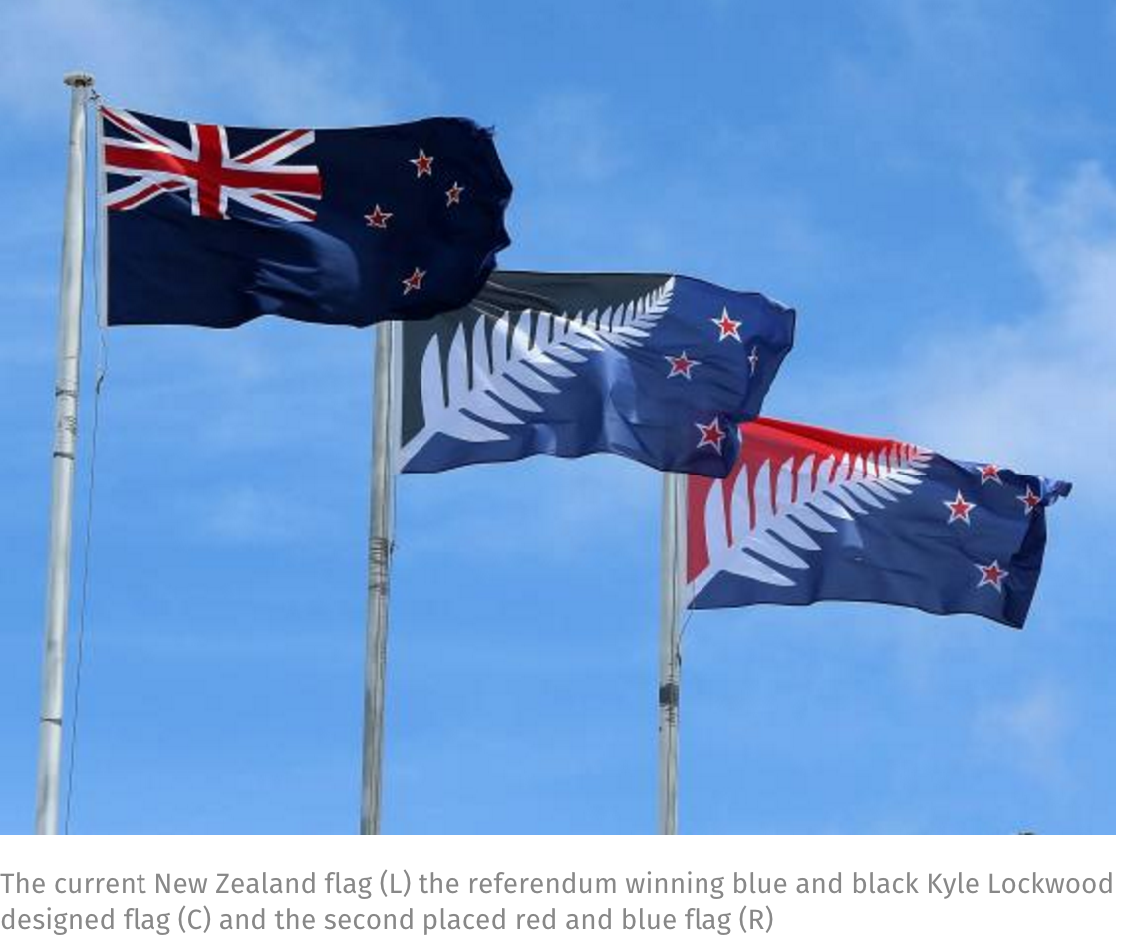
New Zealand
http://www.independent.co.uk/news/world/politics/new-zealands-potential-new-flag-design-says-goodbye-to-the-union-jack-and-welcomes-the-silver-fern-a6773576.html#
Notes:
His winning design has similarities to the current flag but ditches the British Union Jack, or Union Flag, in favor of the fern, which has become a national symbol and is worn by many sports teams, including the beloved All Blacks rugby team. Those who want to change the current flag say it's too similar to Australia's flag and references a colonial past that it's time to leave behind.

Slide 5

Other propositions were

Slide 6

Other propositions were

Slide 7
Motivation
Data is everywhere – and that’s only the beginning
Necessity to be able to handle data, learn from it, predict it
Many tools out there, find the ones that suit your needs

Slide 8
Data Mining
Data Mining is the analysis of data and the use of software techniques for finding patterns and regularities in datasets
Interdisciplinary field involving
Databases
Statistics
Machine Learning
High-Performance Computing
Visualization
Mathematics
In a nutshell: do whatever it takes to extract knowledge from data.

Slide 9

What is Weka?
Waikato Environment for Knowledge Analysis
Data mining toolkit: popular suite of machine learning software and visualization tools
-> Use for data analysis and predictive modeling (regression, classification, attribute selection, clustering)
Continuous efforts since 1994
Notes:
https://en.wikipedia.org/wiki/Weka_(machine_learning)

Slide 10
Why use Weka?
Free availability (GNU license)
Doesn’t require Data Mining expertise
Portability (java is nº1 must-know language for programmers)
Extensibility
Comprehensive collection of data preprocessing and modeling techniques
Nice user-interface for exploration
Active community
One of the most widely used data mining systems
Pedagogical value - also with their book ‘Data Mining: Practical Machine Learning Tools and Techniques’
Notes:
Portability: usability of a software in different environments
Extensibility: dvpt took care of future growth
http://www.tiobe.com/index.php/content/paperinfo/tpci/index.html
http://mashable.com/2015/01/18/programming-languages-2015/#UlO_MUbJOEqA

Slide 11
Hands-on with Weka
Download software (3min)
Load datasets (arff format, 3min, next slide)
Explore Dataset (Preprocess & Visualize panels, 5min)
Run algorithms (Classify & Cluster panels, 2min)
Understand underlying models (after ML explanations)
Notes:
Let’s do all that
Run algorithm, just clicking
Go to next slide for the ARFF format (and open ~/weka_data/iris.arff)

Slide 12
ARFF File Format
Text file describing a set of instances sharing a set of attributes
http://www.cs.waikato.ac.nz/~ml/weka/arff.html
The datatype can be of any of (version 3.2.1):
numeric, <nominal-specification-in-curly-brackets>, string, date [<date-format>]
Missing values are represented by `?’
% The first lines with ‘%’ are usually comments describing the dataset
@RELATION <dataset-name>
@ATTRIBUTE <attribute1-name> <datatype>
@ATTRIBUTE <attribute2-name> <datatype>
@ATTRIBUTE class {Iris-setosa, Iris-versicolor, Iris-virginica}
@DATA
5.1, 3.5, Iris-setosa
4.9, ? , Iris-versicolor
…
Notes:
Case insensitive

Slide 13
Sparse ARFF Files
Similar to ARFF files, except that 0s not represented
Java’s starting index: 0
@data
0, X, 0, Y, 0, 0, “class 1”
0, 0, 0, 0, 0, 13, “class 16”
@data
{1 X, 3 Y, 6 “class 1”}
{5 13, 6 “class 16”}

Slide 14
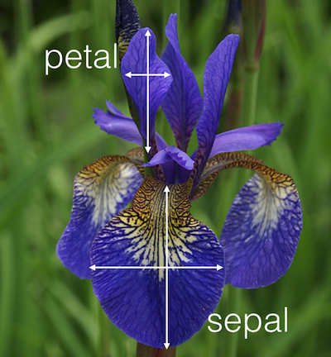
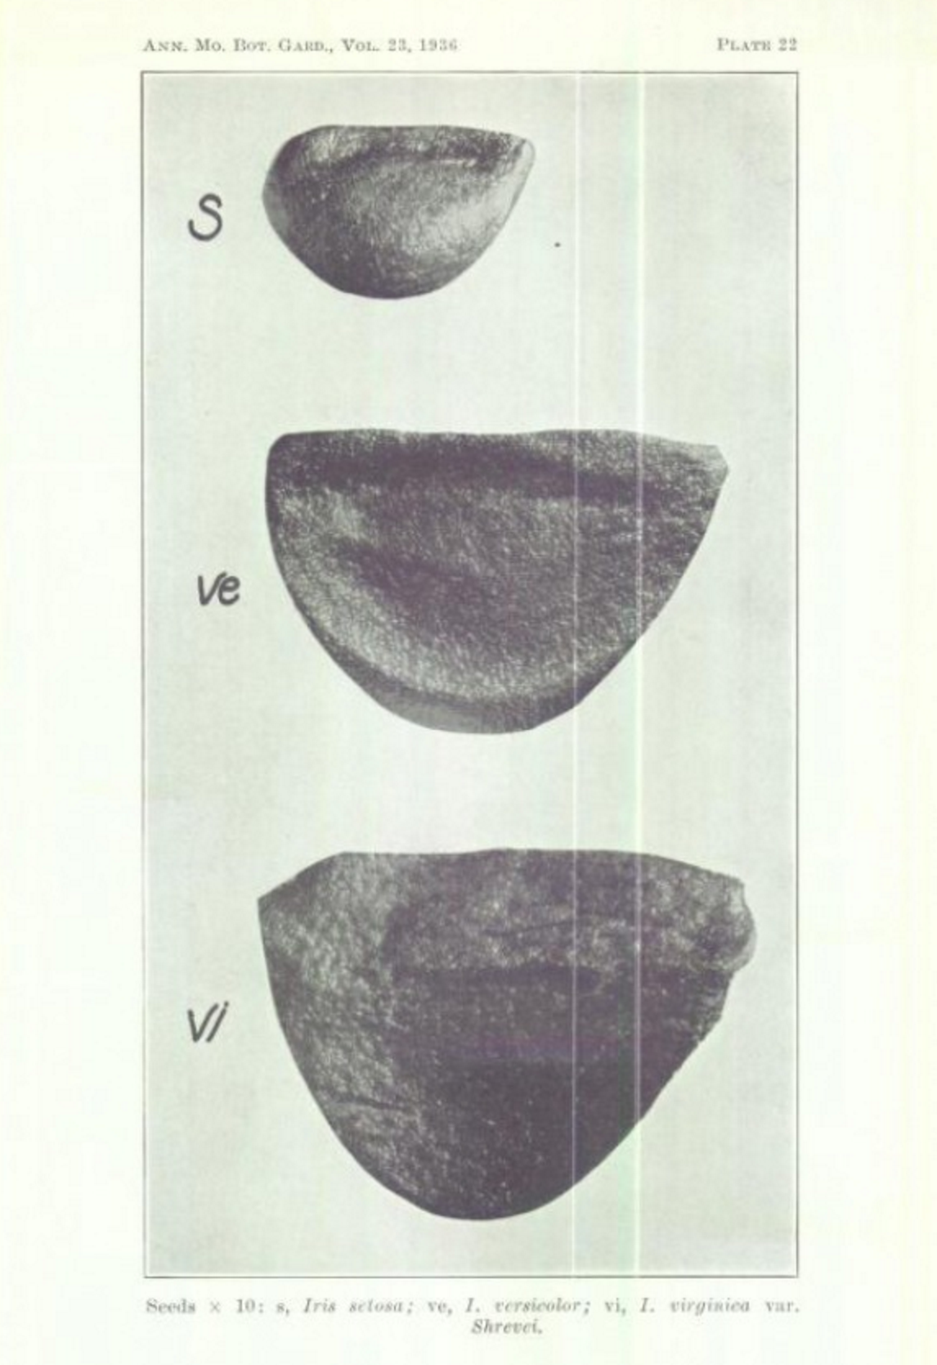
Iris dataset
150 instances, 3 classes (type of iris), 4 features (sepal/petal length/width)
Collected in 1936 by Edgar Anderson ‘The species problem in Iris’ (right: seeds)
Notes:
Very popular, 150 instances, 3 classes, 4 features
http://irisabramson.com/?p=87
http://biostor.org/reference/11559/page/14
Right picture: seeds

Slide 15
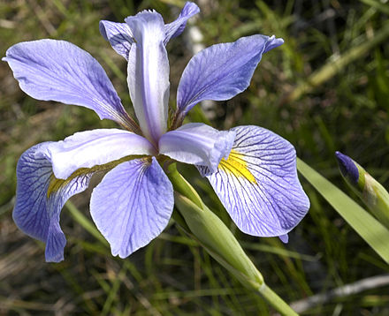
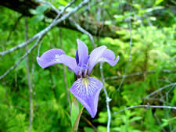
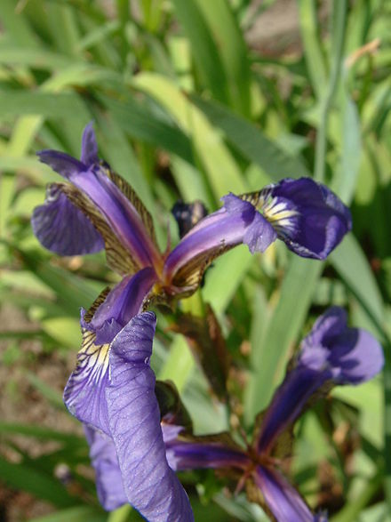
Iris dataset
Virginica Versicolor Setosa
Notes:
Present ARFF format
https://en.wikipedia.org/wiki/Iris_flower_data_set

Slide 16
Machine Learning
Herbert Simon: “Learning is any process by which a system improves performance from experience.”
Tasks:
Classification (labeling)
Regression (guess real value)
Clustering (regrouping similar objects)
Ranking (order a collection, recommendation)
Problem solving (games, calculus, driving)
Attribute selection
Association rules (?)
Notes:
Stress importance of the word ‘performance’; relates to given measure of performance
Same for ‘similar’

Slide 17
Machine Learning
Examples of everyday ML
Google’s ranking algorithm
Spam filters
Face detection
Self-driving cars
Credit card fraud detection
Speech recognition
Digit recognition
Medical diagnosis
Customer segmentation
…

Slide 18
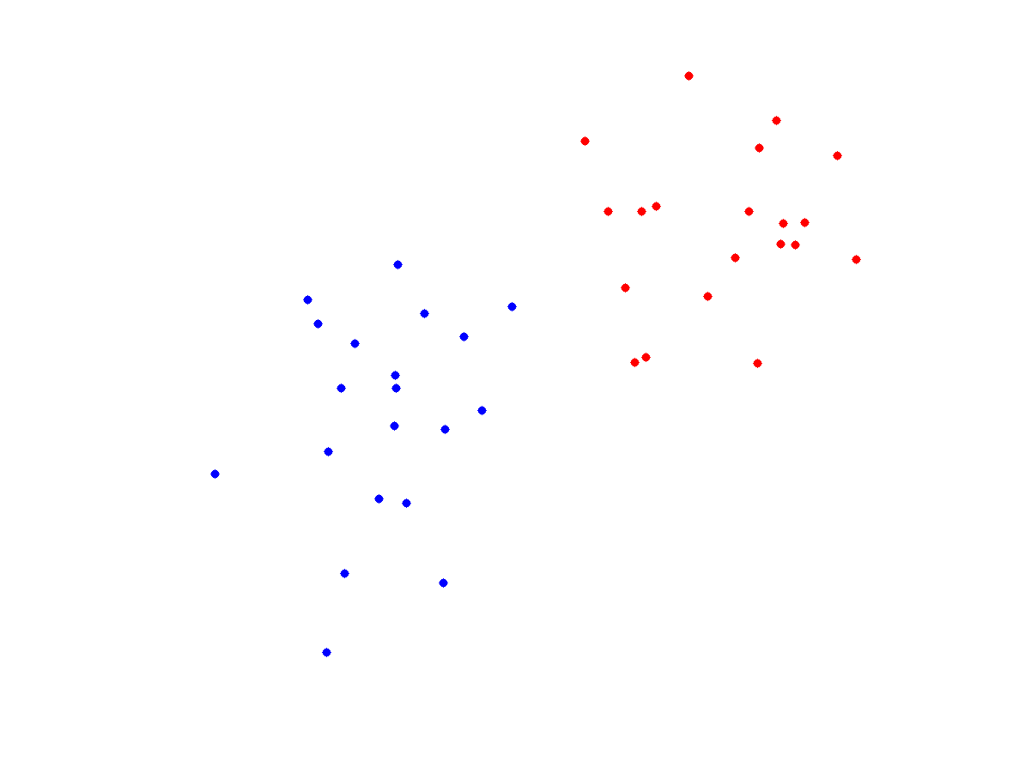
Classification
Notes:
2 classes: how can we make a decision?

Slide 19
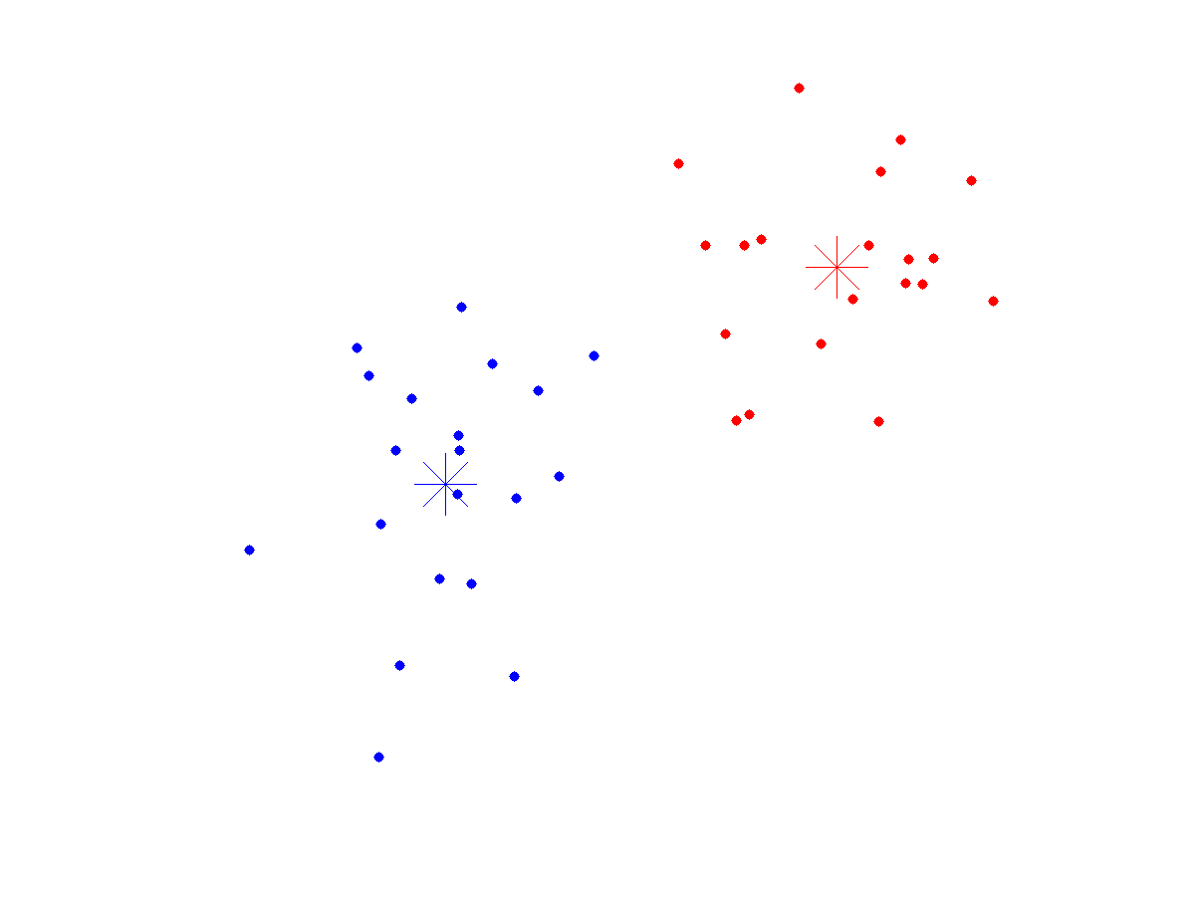
Classification
Notes:
First, let’s be simple: decide using the mean

Slide 20
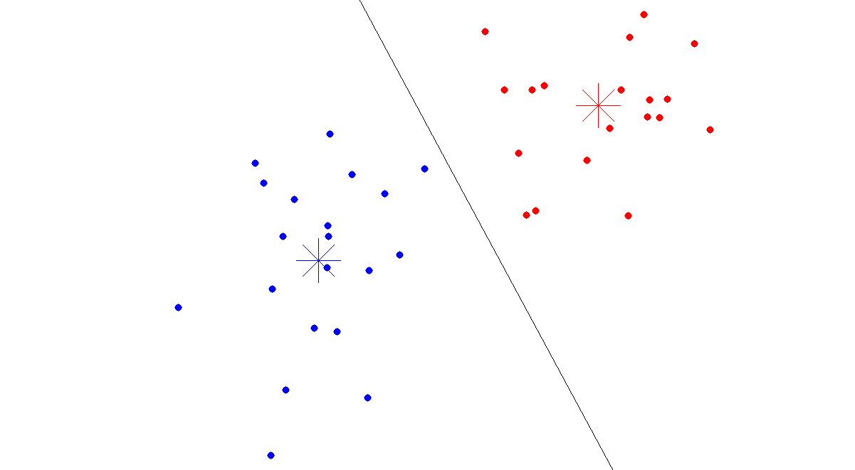
Classification
Notes:
We split the space into 2 using the simple rule: is a point closer to the red mean point, or the blue one?

Slide 21
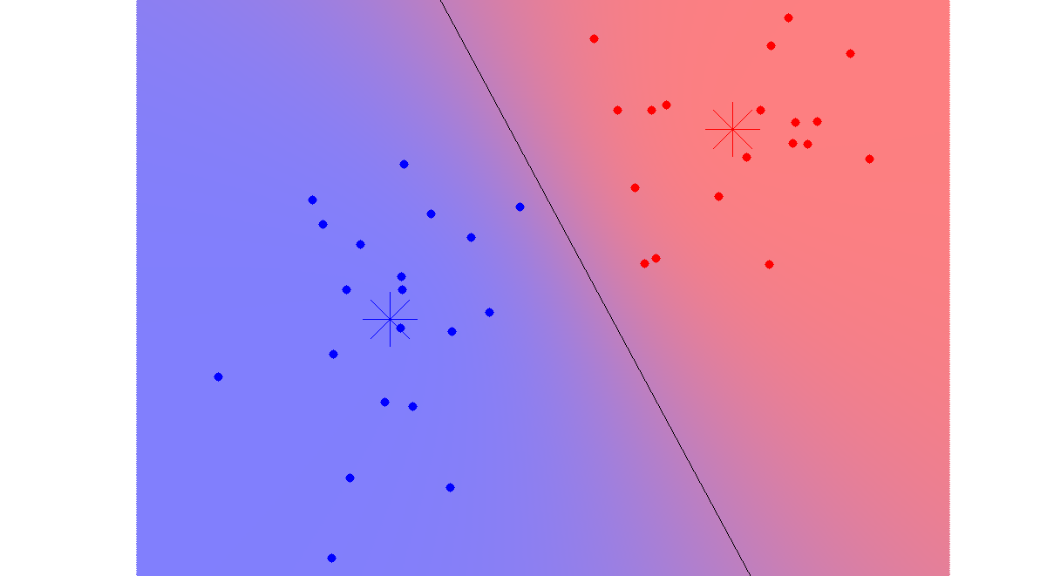
Classification
Notes:
For a new instance, we have a decision

Slide 22
Classification
Many strategies / algorithms
Linear classifiers
Support Vector Machines (well-founded theory)
k-nearest neighbours (decision from neighbours)
Boosting (meta-algorithm)
Neural networks
Many measures of performance
Simplest: percentage of correct classification
Let’s become a classifier
Notes:
ACTIVITY
Tree.UserClassifier with training set
Compare confusion matrix with J48, and visualise its tree

Slide 23
Decision Trees
Decision support that uses a tree-like graph of model of decisions
Weka’s tree.UserClassifier allows the user to manually build a tree, using shapes (e.g. rectangles) on scatter plots
Weka’s tree.J48 builds a decision tree on the features’ values

Slide 24
J48 – Decision tree
Top-down induction of decision trees:
Uses information entropy to select, at each node, which attribute will most effectively split the data
Splitting criterion: Kullback-Leibler divergence (information gain)
Recursively applied in sublists
Stop if all instances have same class

Slide 25
Ibk – k-nearest neighbour
No model – lazy learning
Chooses majority class of the K-nearest neighbours
+++ Very general, only requires a notion of distance
+++ Useful for theoretical studies
--- Computationally costly
--- Doesn’t bring any insight of the data

Slide 26
Problem of Overfitting
Overfitting happens when a model is excessively complex, leading to poor predictive power
Typically, too many parameters relative to the number of observations
Evaluating a model (e.g. J48’s decision tree) should be done using unseen data:
TRAINING DATA ≠ TEST DATA
Notes:
It’s all about fairness

Slide 27
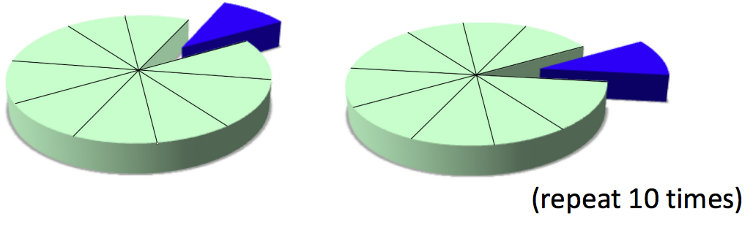
Fairness: training/testing framework
Use training set
Supplied test set
(data sets in 2 different files)
Percentage Split
(ex: hold out 20%)
Cross-Validation
(ex: 10-fold CV)
Notes:
Third plot from DMWW

Slide 28
Weka’s Cross-Validation
Weka performs by default a stratified 10-fold cross-validation, with randomness pre-saved in seeds for reproducibility (instances of all classes are distributed in all folds)
Weka would build 11 models, the first being built on the entire dataset (not used)
Notes:
ACTIVITY
Change the seed and observe the results are slightly different

Slide 29
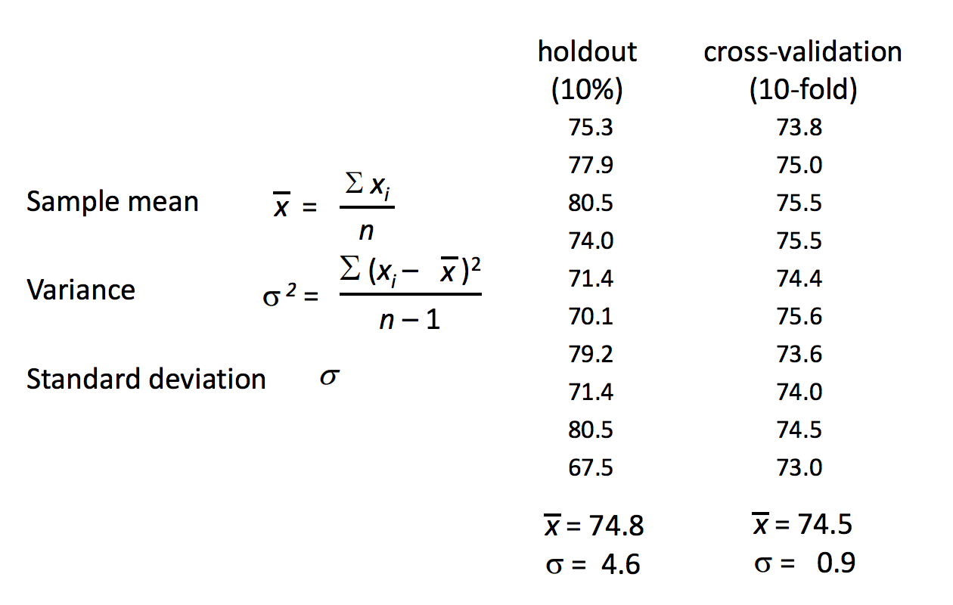
CV better than holdout
CV: Validation protocol widely used (reduces variance of the estimate)
Rule of thumb:
- Lots of data? Use percentage split
- Else, stratified 10-fold Cross-validation

Slide 30
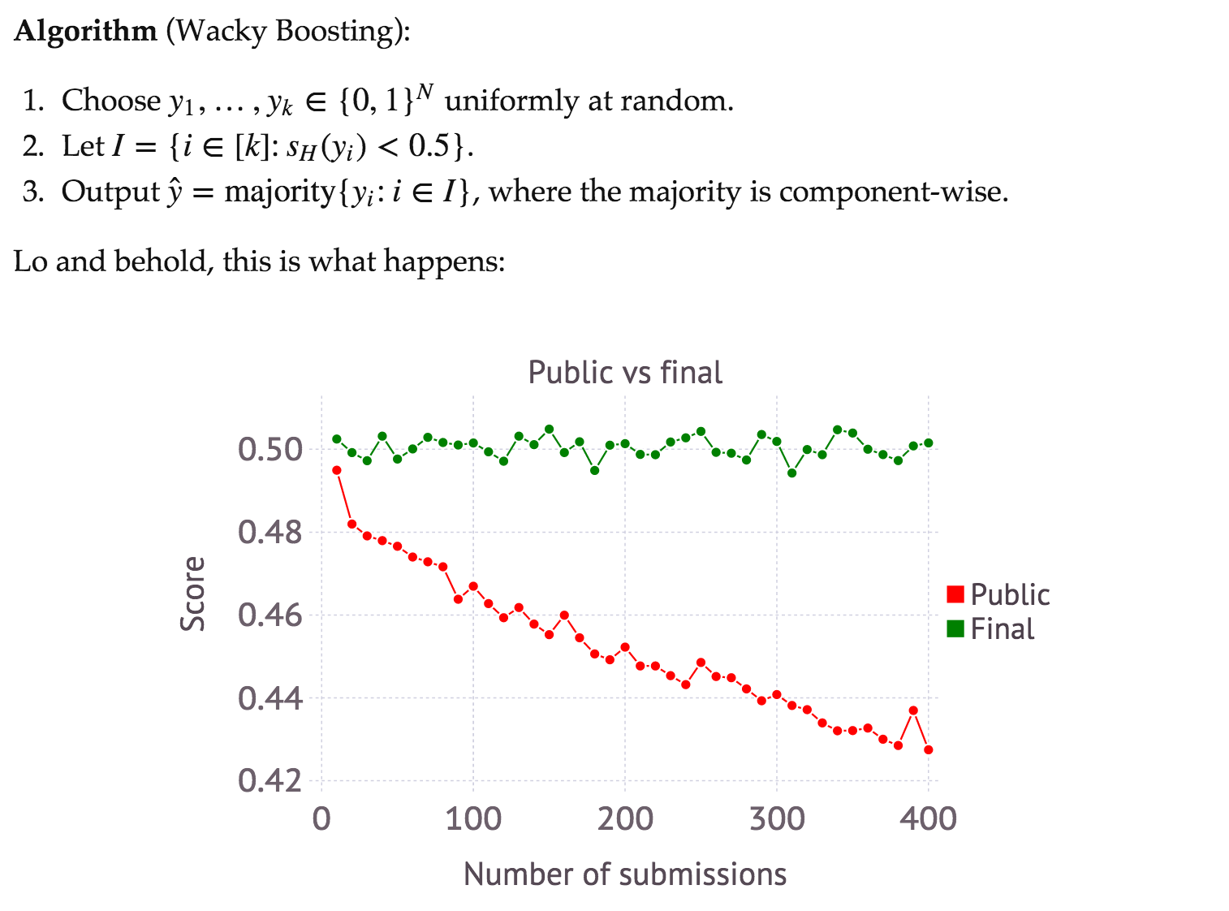
Example of overfitting: Kaggle
http://blog.mrtz.org/2015/03/09/competition.html
Notes:
Perfect submission on public data:
‘Well, rest assured that our submission is intentionally focused on overfitting the public leaderboard score and has essentially no generalization ability to new data (like the private leaderboard score)’

Slide 31
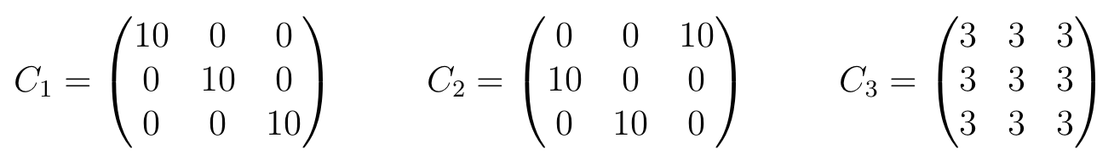
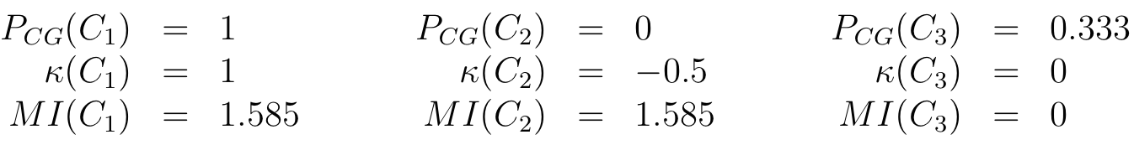
Measures of performance

Slide 32
Measures of performance
We can think of those measures as markers who have different strategies when marking an MCQ test:
Marker 1 would simply give points when the student gives the right answer (Pct),
Marker 2 counts the number of right answers, but wants the students who chose randomly to have 0 in the end (kappa),
Marker 3 gives points if the student shows in any way that he has understood the problem, even if he gives only wrong answers - imagine a stubborn student that decided to always give the solution on the right of the correct one (MI).

Slide 33
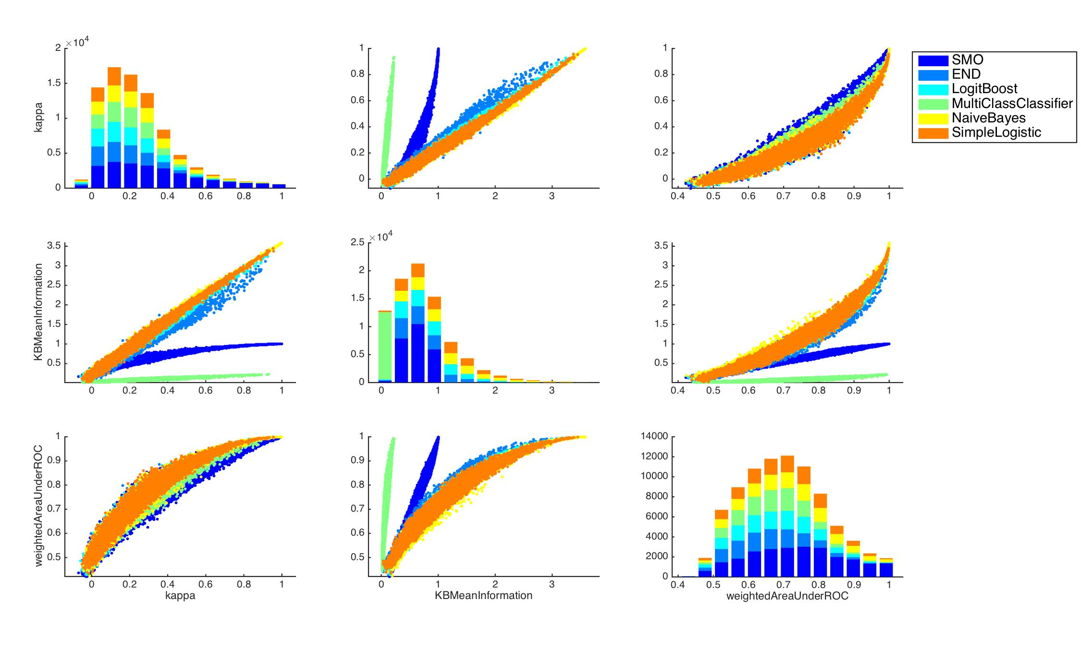
Measures of performance
Notes:
Show different measures in Weka

Slide 34
Data Mining with Weka
How can we learn something about the data using a classifier?
rules.ZeroR (baseline)
rules.OneR (How far can go w/ 1 attribute)
trees.J48 (Efficient decision tree)
lazy.Ib1 (~ lazy.Ibk -K 1)
meta.ClassificationViaClustering (is clustering enough?)
Functions.SimpleLogistic (linear function of attributes)
functions.SMO (SVM)

Slide 35
Weka by command-line
Reference: Weka Primer
Set environment variable CLASSPATH
setenv CLASSPATH path/to/weka/weka.jar
Classification:
java weka.classifiers.<package>.<class> [options]
Important generic options:
-t <training_file> To specify training file
-T <test_file> If none, 10-fold CV by default
-x <number_of_folds>
-d <output_file_save_model> To save the model built
-l <input_file_saved_model> To use a saved model on new data (lower case L)
java weka.classifiers.trees.J48 -t /Users/pmaal/weka_data/iris.arff
java -Xmx1024m weka.classifiers.bayes.NaiveBayes -t \
/Users/pmaal/weka_data/segment-challenge.arff -T /Users/pmaal/weka_data/segment-test.arff -p 0
Options of a given classifier: simply run
java weka.classifiers.bayes.NaiveBayes
Some statistics on a dataset
java weka.core.Instances /Users/pmaal/weka_data/iris.arff
Notes:
Careful with the “-” signs

Slide 36
Dataset: Importance of preprocessing
Importance of features: good data beats complex classifier
There is no single best classifier (but still…)
3 Options (depending on what you do/your skills):
Preprocess before calling Weka (e.g. with Matlab)
Write your own preprocessing as a Weka package
Use Weka’s filters

Slide 37
Dataset: Importance of preprocessing
Notes:
You usually don’t know what features are useful until you try many
SVMs are powerful classifiers

Slide 38
Using Filters
Edit data files
Ex: delete first and second attribute
java weka.filters.AttributeFilter –R 1,2 –I iris.arff –o iris_new.arff
Create new features
Ex: Principal component. Clustering result
Ex: Unsupervised.Attribute.AddCluster with 3 clusters
Attribute selection
Change datatype
Ex: DiscretizeFilter discretizes a range of numeric attributes in the dataset into nominal attributes
Ex: NominalToBinaryFilter converts nominal attributes into binary ones
Can be applied at run time, using meta.FilteredClassifier
Others
classAssigner to change default position of attribute to classify
Notes:
Run some examples to see how it affects the attributes and the final results and models

Slide 39
Package Manager
GUI > Tools > Package Manager
To install 3rd party tools (try some)

Slide 40
Matlab with Weka
Make an .arff file
Addjavapath
Import packages
Create java object
Manage options
Run classification
Notes:
Open file wekaFromMatlab.m and run line by line
Also interfaceable from Python or R

Slide 41
Meka: Multi-label extension to Weka
http://meka.sourceforge.net/
To predict multiple output variables for each instance.
Literally built on top of Weka:
java meka.classifiers.multilabel.BR –t music.arff \
–W weka.classifiers.bayes.NaiveBayes
Run: . ~/Downloads/meka-release-1.9.0/run.sh
Notes:
Not used, only opened it yesterday to see

Slide 42
References
Data Mining With Weka (video series)
http://www.cs.waikato.ac.nz/ml/weka/mooc/dataminingwithweka/
Andrew Ng’s course Machine Learning
Java, must-know language:
http://www.devtopics.com/most-popular-programming-languages/
Weka tutos:
http://www.cs.ccsu.edu/~markov/weka-tutorial.pdf

